Slide 1

<gameChallenge_>

Slide 2

<index_>
<theCreators_>
<thePurpose_>
<theGame_>
<theCharacters_>
<theGoal_>
<theThanks_>

Slide 3





<theCreators_>
<Rodrigo “Sushiman”
Sokolosk_>
<José “Baby”
Maria_>
<Patrícia
Iaczinski_>
<Américo “Mego”
Santos_>
<João Policarpo_>

Slide 4


<thePurpose_>
private String thePurpose = “After being inspired by Super Mario Bros, Sonic and Donkey Kong, we wanted to create this game for the next generation of gamers”;
<Java_>
<IntelliJ_>
<SimpleGrafix library_>

Slide 5


<theGame_>

Slide 6
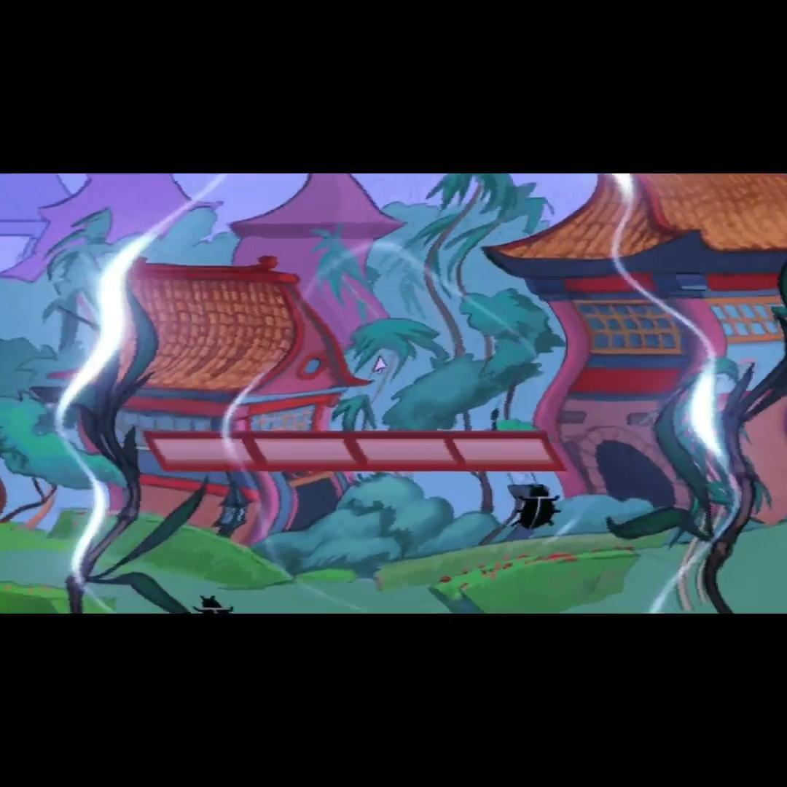

Slide 7





<theCharacters_>
>
<theFeaturedFlyingFirstShellmurai_>
<mcPaulo “Dexter”_>
<mcSara “Kenny”_>
<mcPedro “Alex”_>

Slide 8
<theGoal_>
private String theGoal = “Get through a few levels where theFeaturedFlyingFirstShellmurai faces some challenges we are all very familiar with”;

Slide 9

<theThanks_>

